Slide 1
ON412
Radio Waves, Frequency, and Modulation
Week 5

Slide 2
Agenda
Radio Waves
Frequency
Modulation

Slide 3
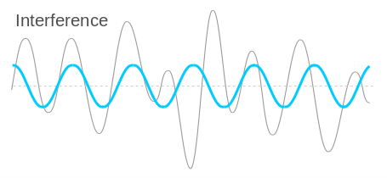
What are Radio waves?
Radio waves are a type of electromagnetic wave used for wireless communication. They travel through the air and can carry information over long distances.

Slide 4
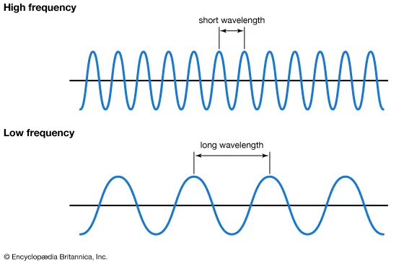
What is Frequency?
Frequency refers to the number of oscillations or cycles a wave completes in one second, measured in Hertz (Hz). Higher frequencies correspond to shorter wavelengths and vice versa.

Slide 5
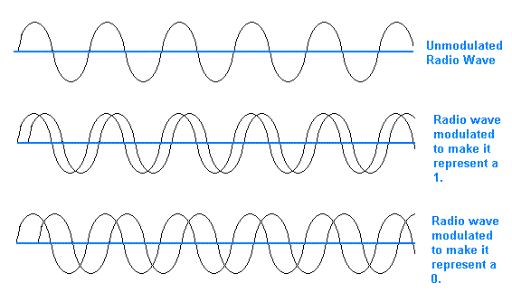
What is Frequency?
Modulation is the process of varying a carrier wave to encode information. There are two main types of modulation used in radio communication:
Amplitude Modulation (AM)
Frequency Modulation (FM)

Slide 6
Q&A
Now is your time to ask questions…

